Slide 1

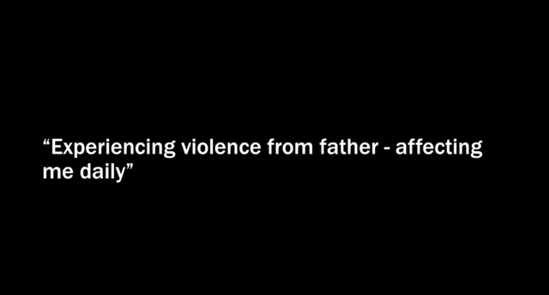
How to Help
Natural Disaster
A guide to disaster relief-Germany Kent
Victims

Slide 2

FACTS

Slide 3
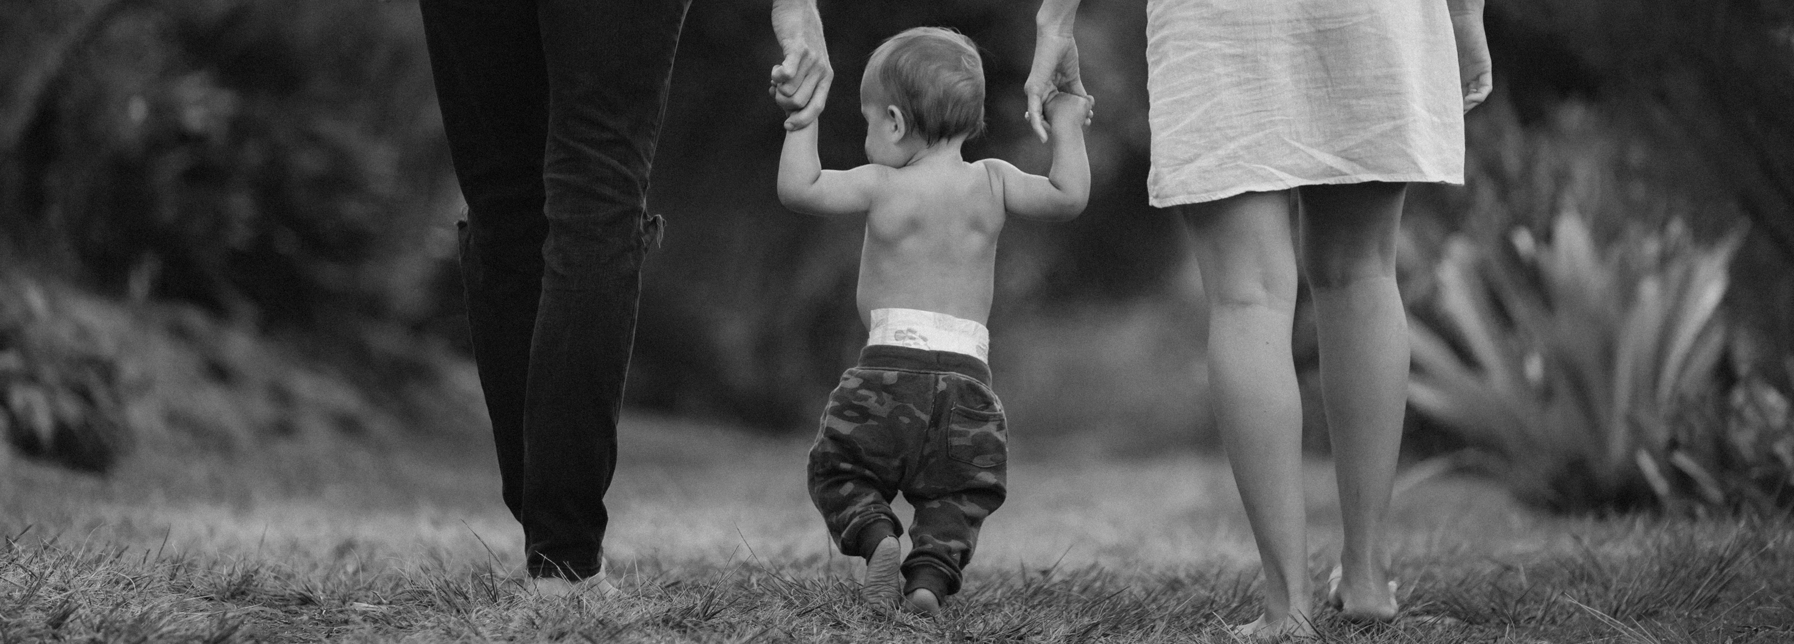
PREVIOUS RESEARCH
Domestic Violence crisis identification from Facebook posts based on Deep Learning
Intent classification using Feature Sets for Domestic Violence discourse on Social Media
Extracting actionable knowledge from Domestic Violence discourse on social media
Use collaborative efforts with social workers and psychologist to classify social media comments into five classes:
DV survivor(Personal Story)
Seeking Financial help (Fund Raising)
Awareness promotion (Awareness)
Expressing empathy (Empathy)
Irrelevant to DV (General)

Slide 4









OUR APPROACH
Reddit
Data Cleaning
Sentiment Analysis VADER
NLP techniques: Stop- words/stemming/
Lemmatization/pos tagging
Word Cloud
Twitter
Demographic and Globalization investigation
Online News
Features extraction
Topic 1
Online website as a repository with all the insights to help with:
Topic 2
Topic Modeling using LDA (Latent Dirichlet allocation)
- Domestic Violence research analysis
- Policy-making and initiatives for intervention by NGOs and government
Topic 3

Slide 5
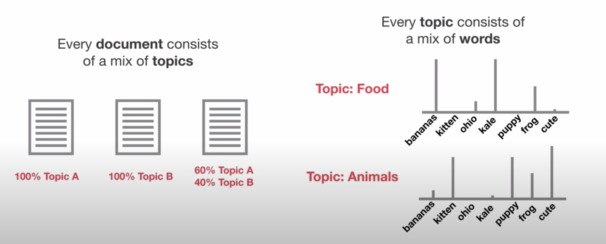
TOPIC MODELING

Slide 6
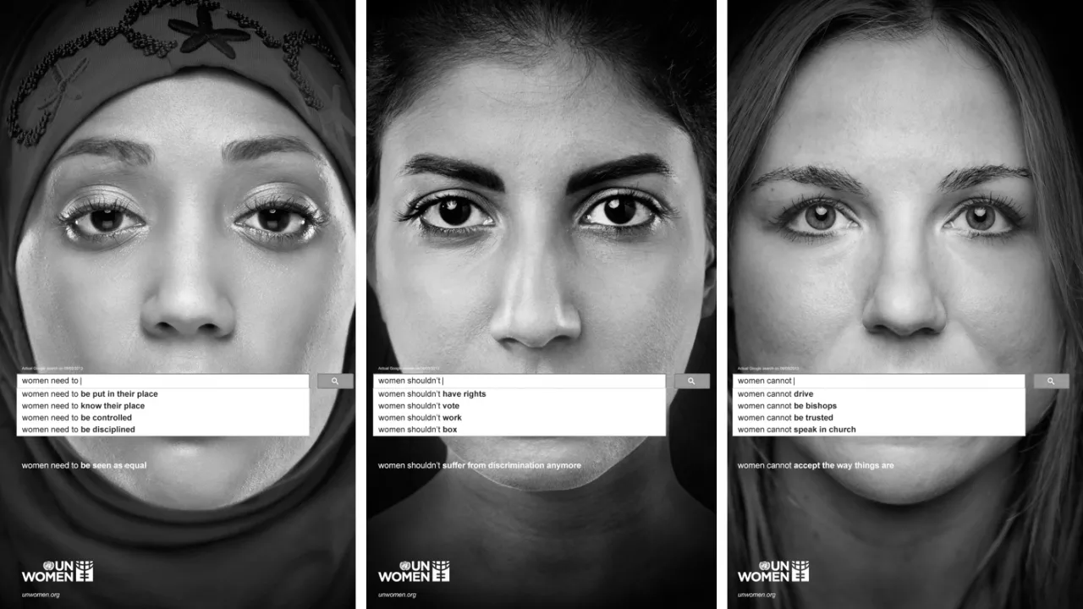
OUR DEMO
https://bfdelavega.wixsite.com/misitio

